Slide 1
An
API-FIRST
Approach
The Best Approach to API Development
Notes:
# The reason
- help to improve the productivity in software development.
- a lot of benifits of this approach when applied to FY-Everything ecosystems.

Slide 2
Ho Minh Chung
ID : 143714
Group: AxS Modelling - DC9 - DG4
Email : hmchung@tma.com.vn / hmchung92@gmail.com
Phone: 0906 246 489
About Me

Slide 3
API-FIRST DESIGN
Agenda
3
1
Current problem in API development
2
How to Resolve the problem?
3
Why API-First Development?
4
Technologies
Notes:
What – is current issue
How - to resolve the problem
What – is API-FIRST
Why – use API FIRST
Which - technologies

Slide 4





Current problem in API development
Business opportunity
Strategic documentation
Task assignment
Code First
Design First
Contract/
Documentation
Contract/
Documentation
Code the API
Code the API
Current approach
New approach
Notes:
Need your feedback, do we need to add the idea/solution for the problem in this page?
Is it good if we create another the page like this to talk about “Design first”?

Slide 5

How to Resolve the issue?
Code First
VS
Design First
Web
Client
Android
Client
IOS
Client
Web
Client
Android
Client
IOS
Client
3
2
SDK
SDK
SDK
SDK
SDK
SDK
API
API
API
Front-end teams
1
Mock
Mock
Mock
2
Impl
Impl
Impl
2
API
Back-end teams
Impl
1
Data
Services
Notes:
- The Code First approach is more traditional approach to building APIs, the implementing of code happening after the business requirements are provided, and generating documentation from the code.
- The Design First approach is designing the API’s contract fist before writing any code. This is a new approach, it is fast catching on, especially with the use of API description formats.

Slide 6
Why API-First Development?
Improved API Design
Iterate Faster Across Multiple teams
1
2
3
4
Create Tests for Your API
Generate Code
And Documentation
Notes:
Why we should use FIRST API approach in API Development?

Slide 7
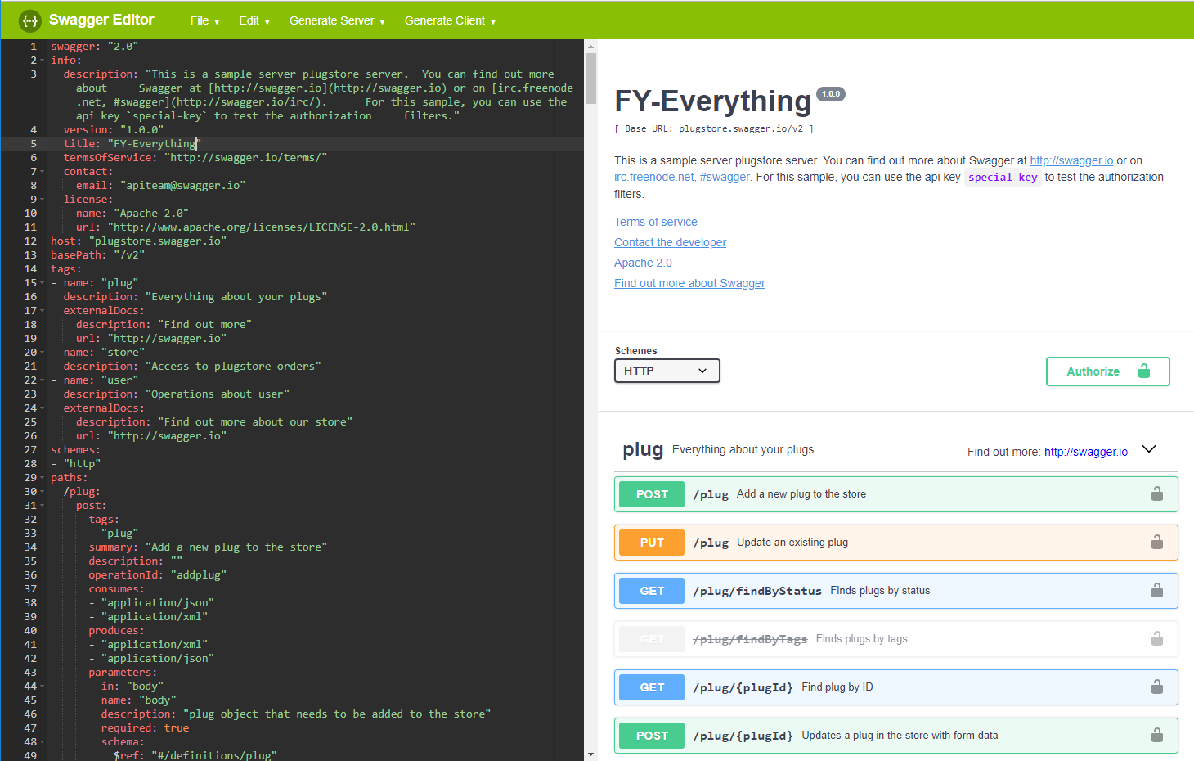
Why API-First Development?
Improved API Design
Provide Feedback
Immediately Interact
Consistent Design
Identifying Issues

Slide 8

Why API-First Development?
Iterate Faster Across Multiple teams
Web
Client
Android
Client
IOS
Client
2
SDK
SDK
SDK
API
API
API
Front-end teams
1
Mock
Mock
Mock
Impl
Impl
Impl
2
Back-end teams
Data
Services
Enhance Teamwork And Collaboration
Notes:
Your API specification provides a contract that describes what a successful response will look like when someone calls your API.
With an API specification, development projects that involve multiple teams( backend, web, mobile, etc) can proceed much better than traditional methods would allow.
- Front-end teams can immediately start building components that dont need to wait backend components are ready because we can generate and run mock services based on an API specification.
- Team can work independently/parallel (ˈpærəlel / song song), without having to wait for a member to complete a step first.

Slide 9
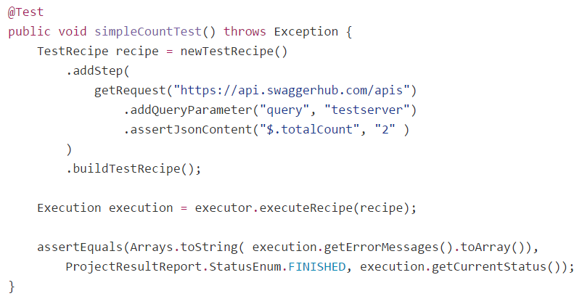
Why API-First Development?
Create Tests for Your API
Mock Legacy Systems
API
Component
Testing Tool / Framework
API
API
Mock Peer
Services
API
Mock 3rd Party Component
API MOCK
is created automatically
Notes:
Automatically generate tests from your API definitions which can decrease amount of effort needed to testing your APIs.
Easily‬‎ create test suites and test cases for your own REST APIs workflows, define the requests and simply run the tests to verify your APIs are working both from mocks and your real API.

Slide 10
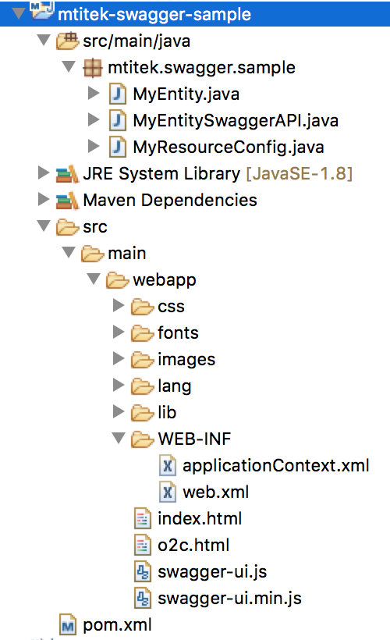
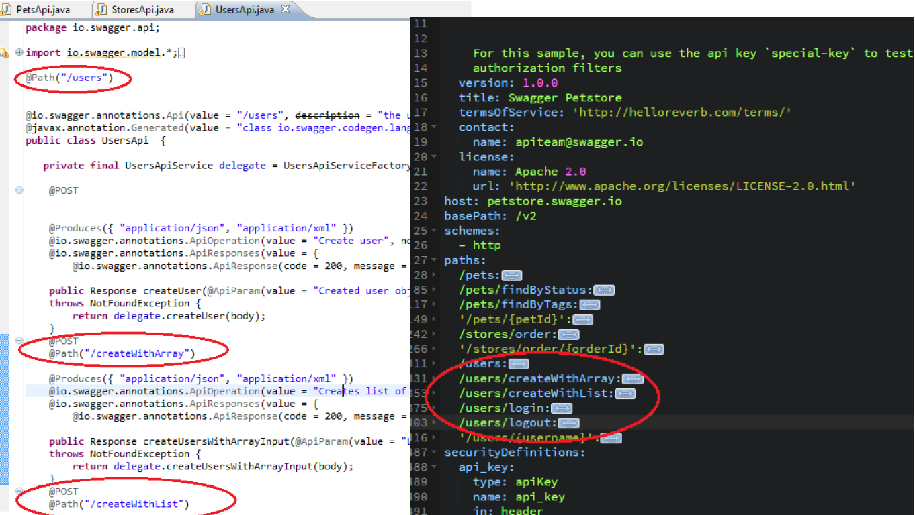
Why API-First Development?
Generate Code and Documentation
Visually design your API without coding knowledge
Notes:
Automatic code generation in your favourite languages like Node, Java, Swift, PHP, Go and many more and generate an API reference and client SDKs that communicate with the API.

Slide 11
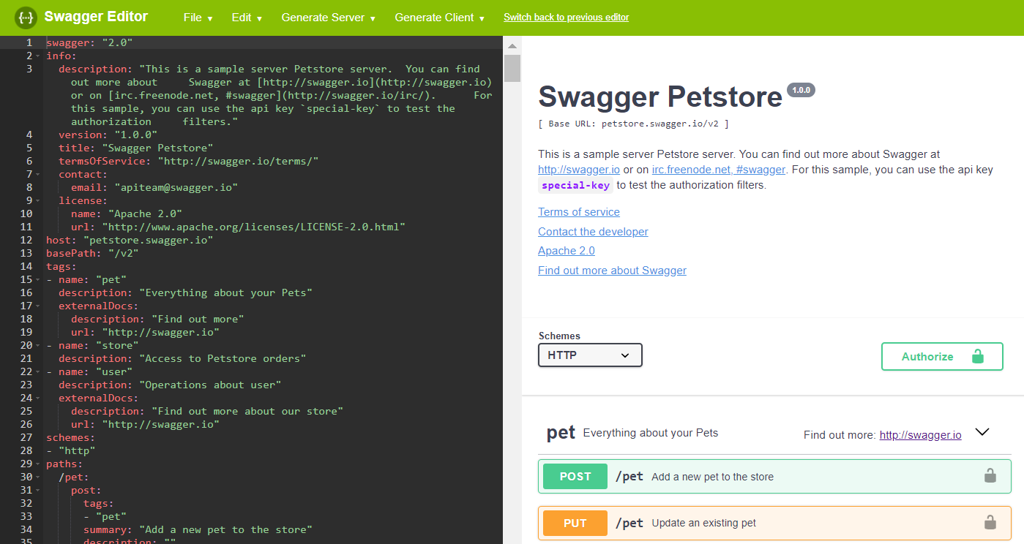
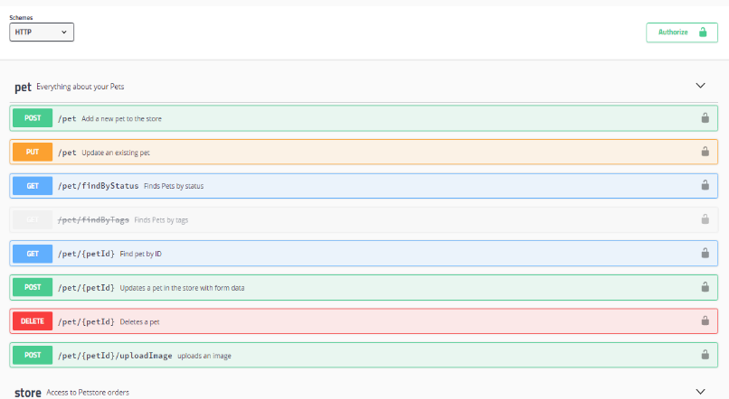
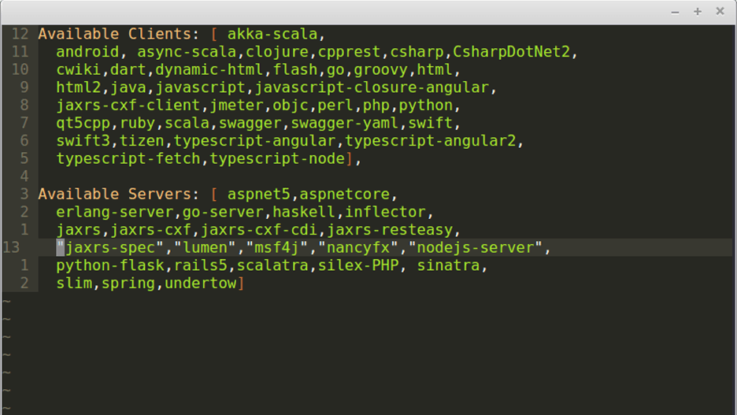
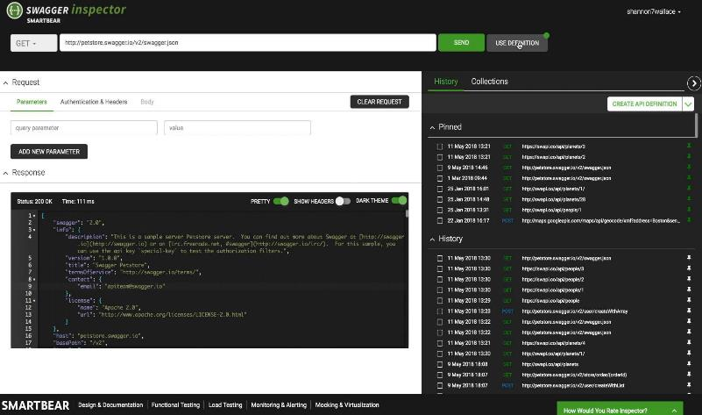
Technologies
1
Swagger Editor
2
Swagger UI
3
Swagger Codegen
4
Swagger Inspector
Notes:
Swagger project is open source and sponsored by SMARTBEAR
Swagger Core Java-related libraries for generating and reading Swagger definations
Swagger Editor lets you edit OpenAPI specifications in YAML inside your browser and to preview documentation in real time.
Swagger UI allows anyone (your team) to visualize and interact with the API’s resoruces without having any of the implementation logic in place.
Swagger Codegen command-line tool for generating both client and server code from a Swagger definition.
Swagger Inspector: API Inspection tool that lets you generate OpenAPI definitions from existing API.

Slide 12
Thanks for your
Listening

